Slide 1
Eden II
Gary Chi
Raisa Rabbani
Elon Xie
Jessica Z

Slide 2

What Is It?
Intuitive and easy to use mobile app
Helps caretakers understand kids
Can retain unique language of each child
All made available to caretakers
Notes:
30 seconds Gary

Slide 3
How it works
Initial: Users input audio data of phrases
Translation: Caretaker/Parent records the child speaking
This is translated to text
Editing: Translations can be edited if incorrect
Notes:
1 min Elon

Slide 4
How does it Solve the problem
Each caretaker’s app has its own pool of children to attend to
A database retains data for each individual
Compares data derived from audio with reference data
Notes:
1 min Gary

Slide 5
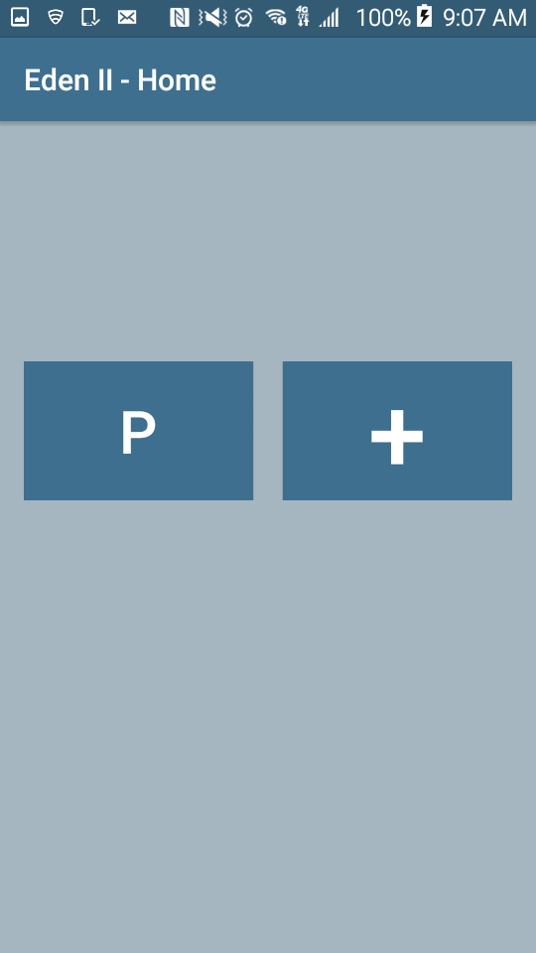
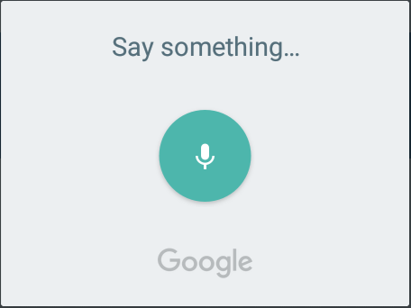
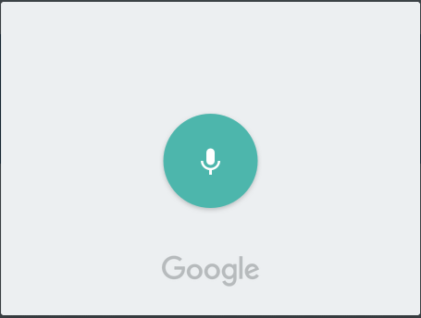
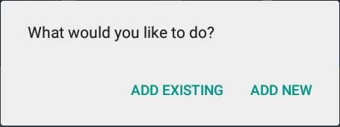
A
B
Albert Beth
Pearl Add
Abbaypa
Even II
Results Screen

Slide 6
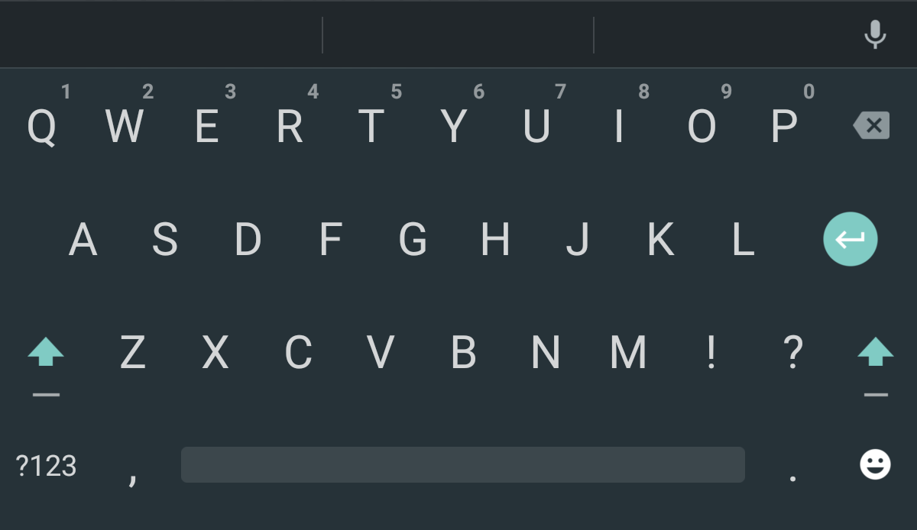
No results :(
What does this mean ?
A
B
Albert Beth
Pearl Add
Even II
✓
Results Screen

Slide 7
No results :(
What does this mean ?
A
B
Albert Beth
Pearl Add
want iPad
Even II
✓
Results Screen

Slide 8
A
B
Albert Beth
Carl Pearl
Add
C
P
Even II
+
Home Screen

Slide 9
A
B
Albert Beth
Pearl Add
Even II
Home Screen

Slide 10
A
B
Albert Beth
Pearl Add
Abbaypa
Even II
Results Screen

Slide 11
A
B
want
iPad
Albert Beth
Pearl Add
Even II
✓
Results Screen

Slide 12
A
B
want
iPad
Albert Beth
Pearl Add
Even II
✓
Results Screen

Slide 13
Eden II
Splash Screen

Slide 14
A
B
Albert Beth
Pearl Add
Even II
Home Screen

Slide 15
A
B
Albert Beth
Pearl Add
Even II
Home Screen

Slide 16
A
B
Albert Beth
Carl Pearl
Add
C
P
Even II
+
Home Screen

Slide 17
A
B
Albert Beth
Pearl Add
Even II
Home Screen

Slide 18
Future Improvements
Complete MVP
Additional security in data transfer
Accounts for caretakers
Machine Learning/Audio fingerprinting
Notes:
Raisa 30 sec

Slide 19
Thank You For Listening
Questions?

